Slide 1
Insights into Lending Risks
Optimizing Loan Approvals Through Identification Risky Applicant
Amaan Shaikh
Senior Analyst at Tiger Analytics

Slide 2
Table of content
Background
Business Problem
Dataset Overview
Objectives
Data Cleaning & Preprocessing
Key Insights
Numerical Variables (Part-1)
Numerical Variables (Part-2)
Categorical Variables (Part-1)
Categorical Variables (Part-2)
Categorical Variables (Part-3)
Categorical Variables (Part-4)
Indirect Impact Factors
Recommendations
Challenges & Assumptions
Conclusion
GitHub Repository

Slide 3
Background
Company:
Challenge:
Focus:
Largest online loan marketplace facilitating personal and business loans.
High financial losses due to loan defaults.
Analyze historical loan data (2007–2011) to identify default risky applicants.

Slide 4
Business Problem
Problem:
Solution:
Financial losses caused by loan defaults.
Need for identifying risky loan applicants during the approval process.

Slide 5
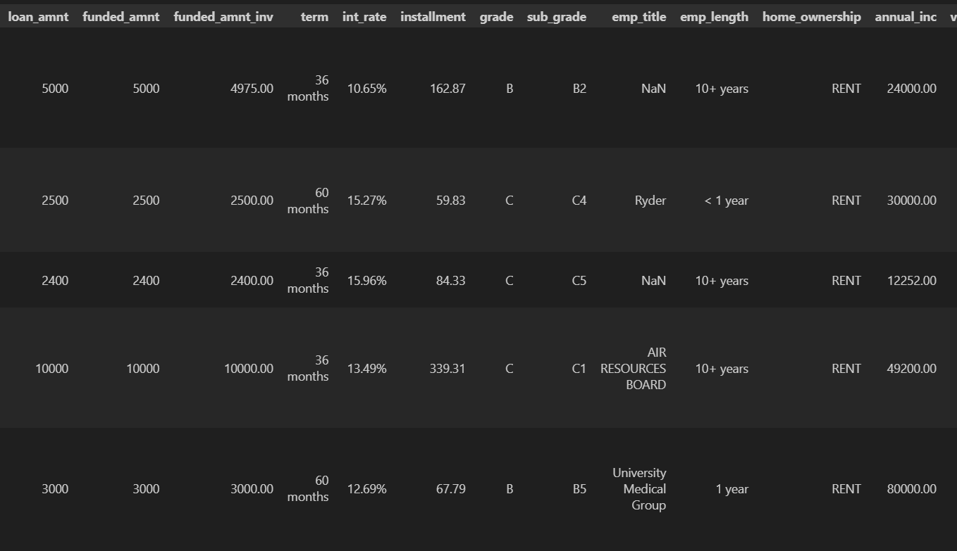
Dataset Overview
loan.csv: Historical loan data (2007–2011).
Data_Directory.xlsx: Variable descriptions.
Key Features: Loan amount, interest rate, annual income, credit history, etc.

Slide 6
Objectives
Conduct exploratory data analysis (EDA) to:
Identify strong indicators of loan default.
Highlight potential risky applicants.
Provide actionable recommendations.

Slide 7
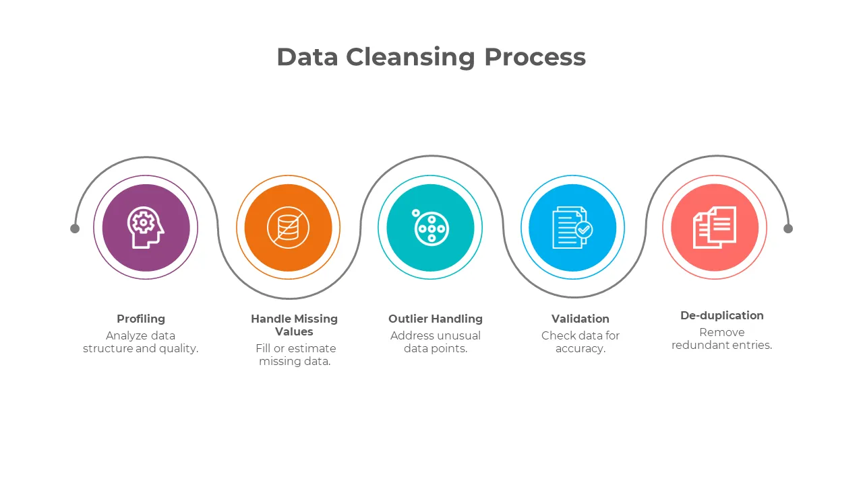
Data Cleaning & Preprocessing
Handled missing values and outliers.
Applied log transformations to reduce skewness.
Engineered features: credit_history_length, time_since_last_payment, etc.

Slide 8
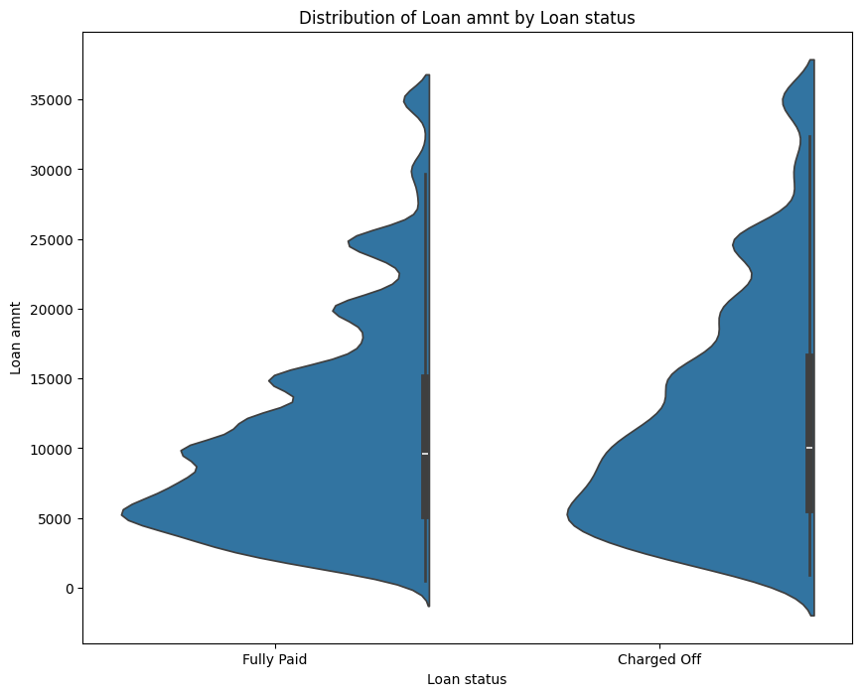
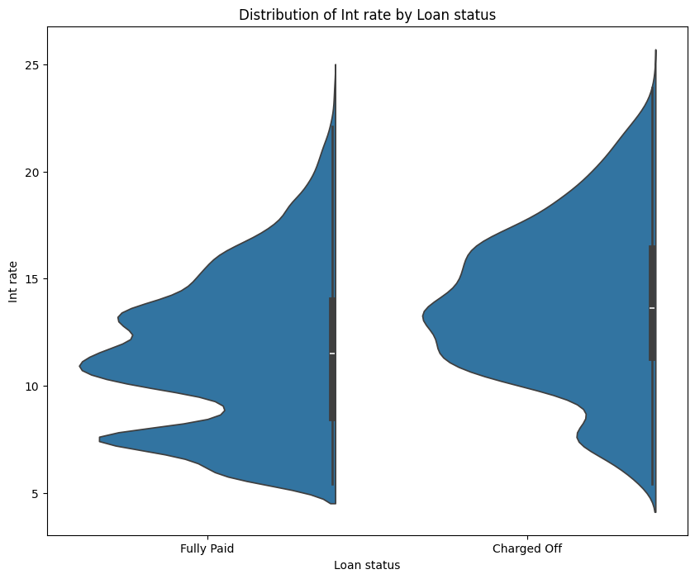
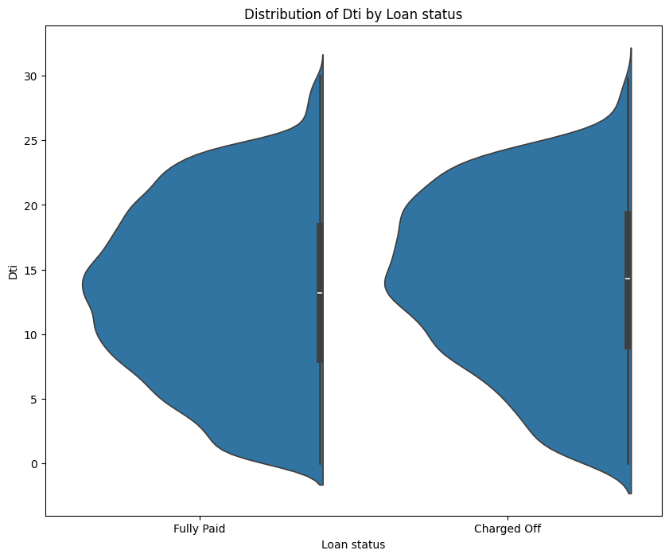
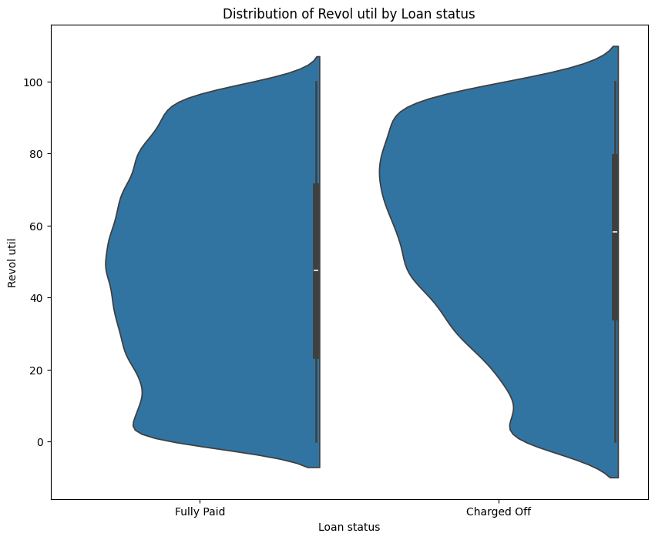
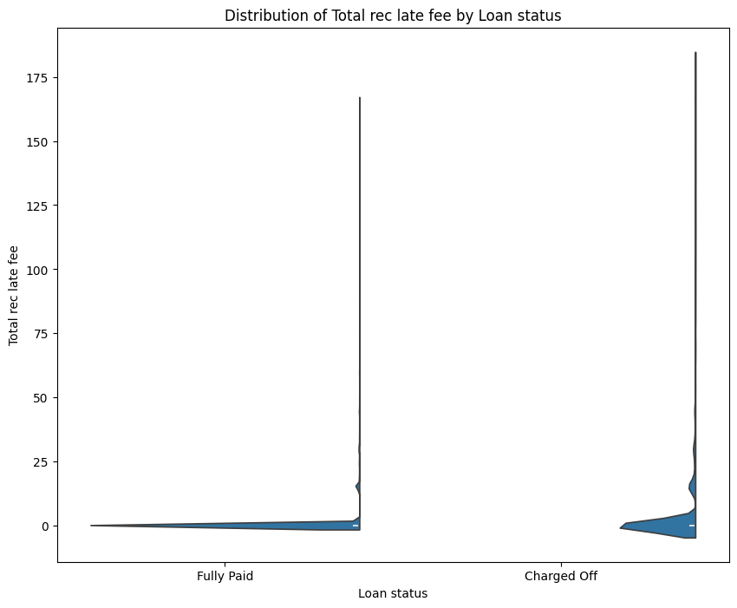
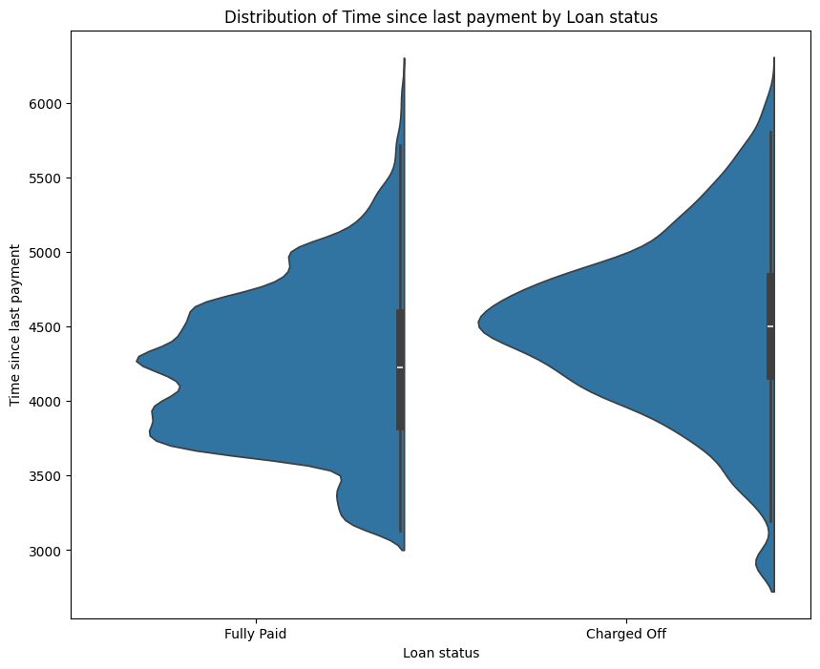
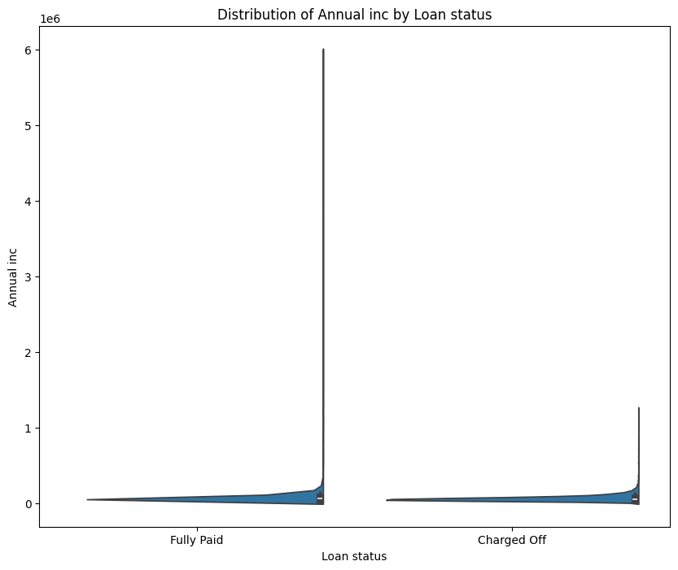
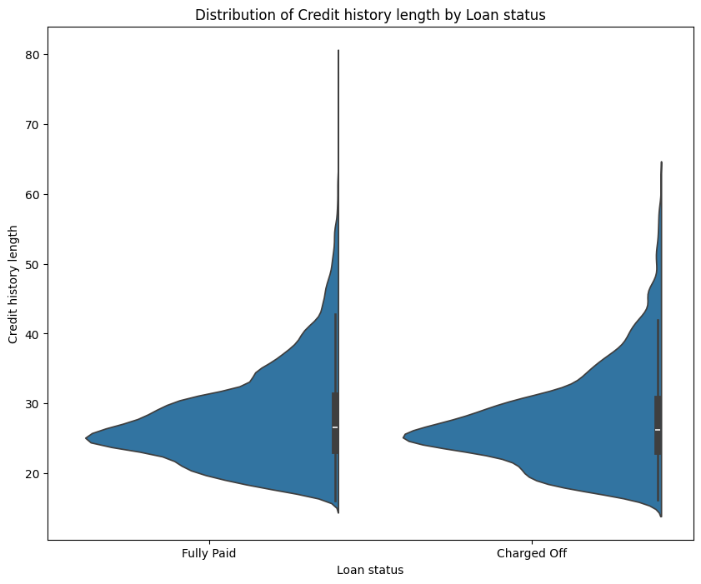
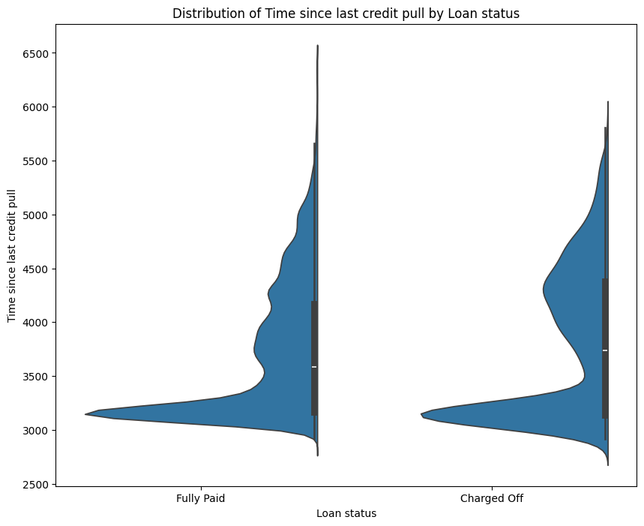
Key Insights –
Numerical Variables (Part-1)
Risky Applicant Indicators:
🔼 High loan amounts[Loan amnt]
🔼 High interest rates [int rate].
🔼 High debt-to-income ratio[dti]
🔼 High revolving utilization rate[Revol util].
🔼 High count of late fee received to date[Total rec late fee]
🔼 High day count since last payment[Time since last payment]
🔽 Low annual income [Annual inc]
🔽 Low short credit history [Credit history length]
🔽 Less day count since last credit pull [Time Since last credit pull]

Slide 9
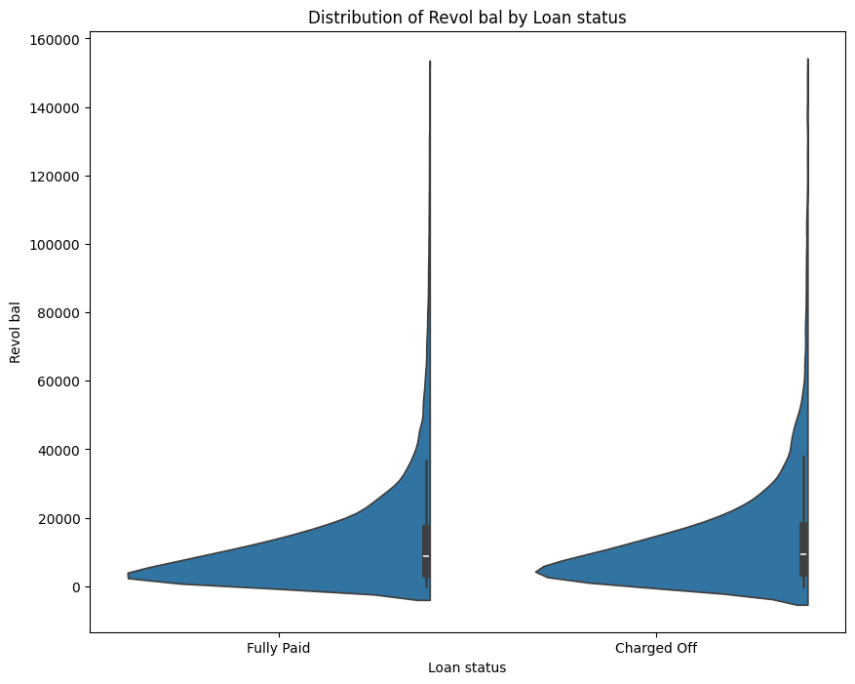
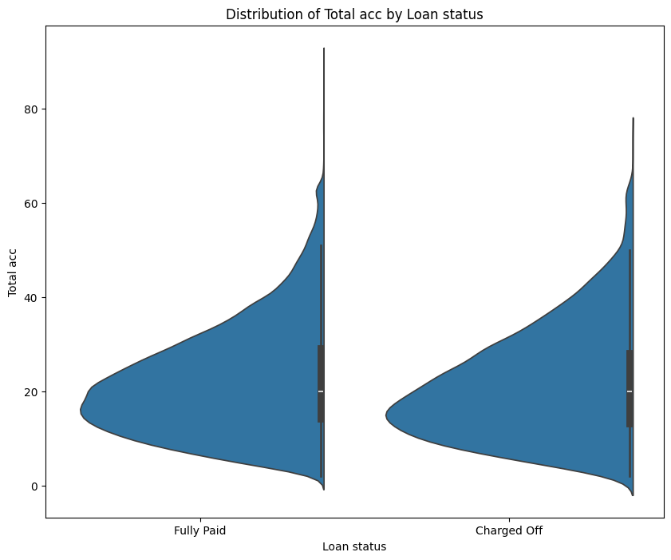
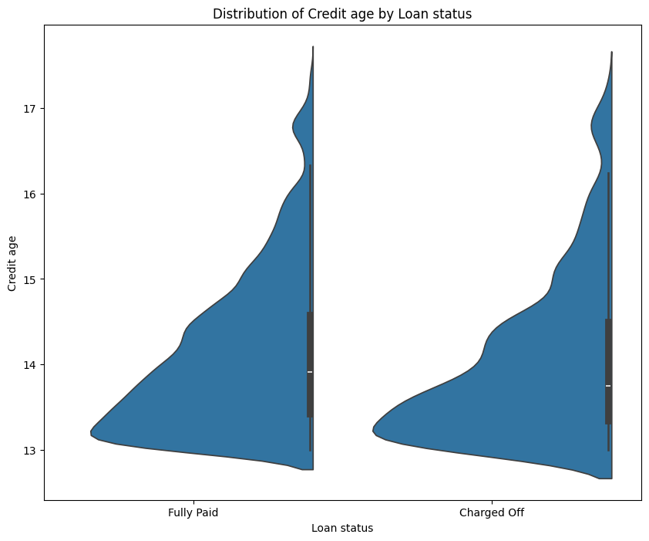
Key Insights –
Numerical Variables (Part-2)
Factors with Minimal or No Impact visible on charts:
Total credit revolving balance
Total number of credit lines currently in borrower’s credit file
Total number of years borrower’s credit history present

Slide 10
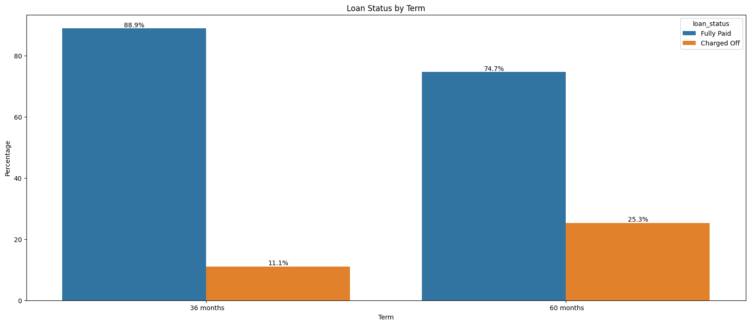
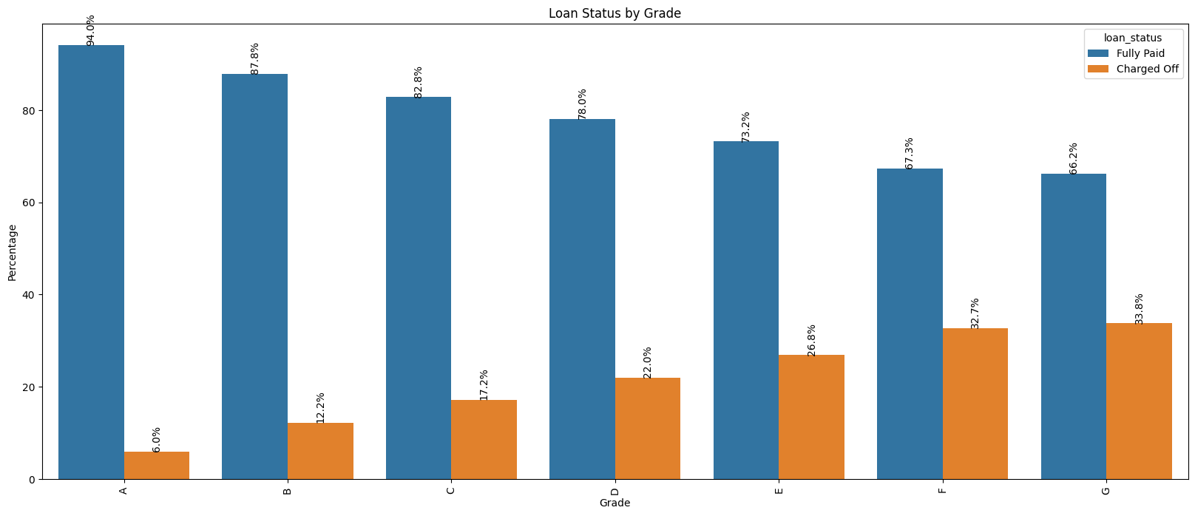
Key Insights –
Categorical Variables (Part-1)
Risky Indicators:
Loans with a 60-month term have a significantly higher default percentage.
As grade value increasing, default percentages increase, indicating a strong correlation with risk.

Slide 11
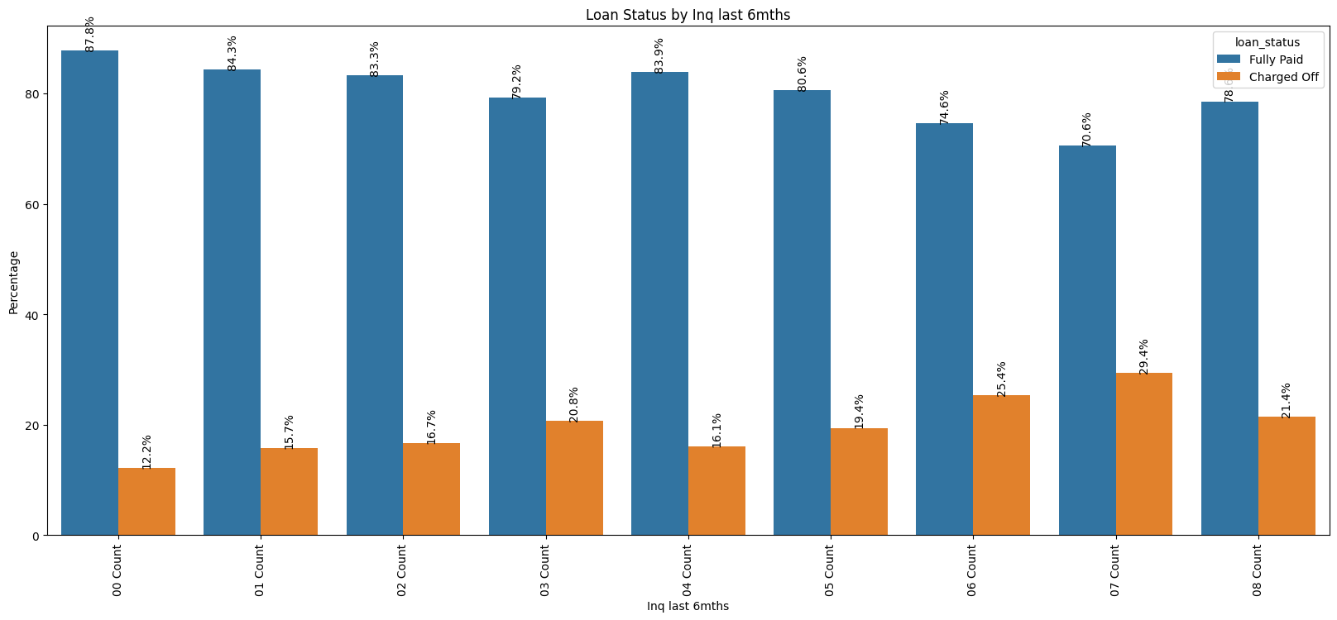
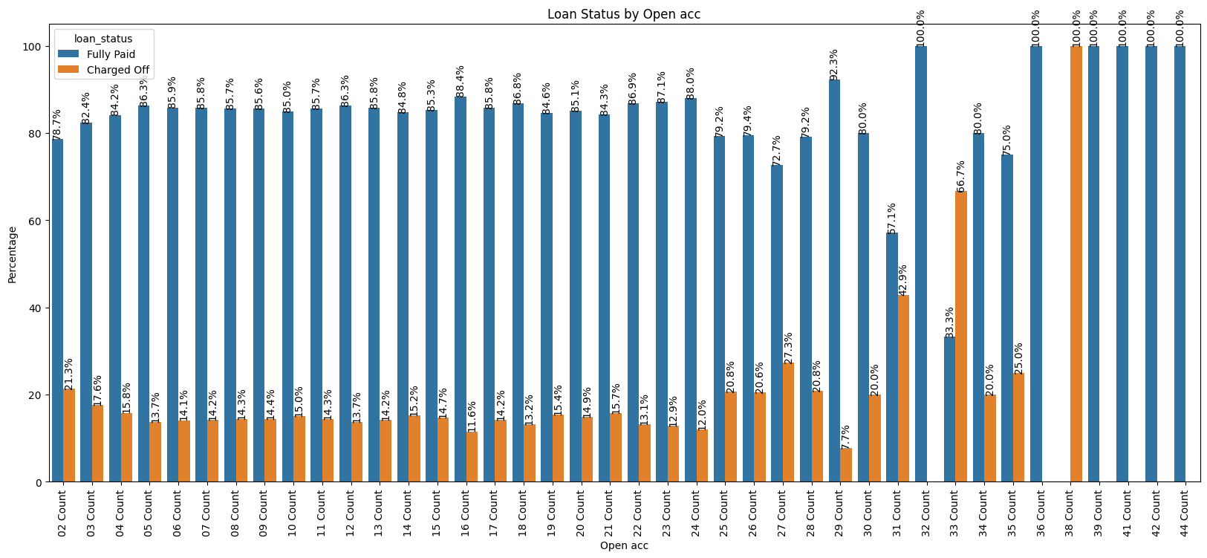
Key Insights –
Categorical Variables (Part-2)
Risky Indicators:
Higher inquiries in the last 6 months correlate with increased default percentages.
Higher number of open accounts is associated with increased default risk.

Slide 12
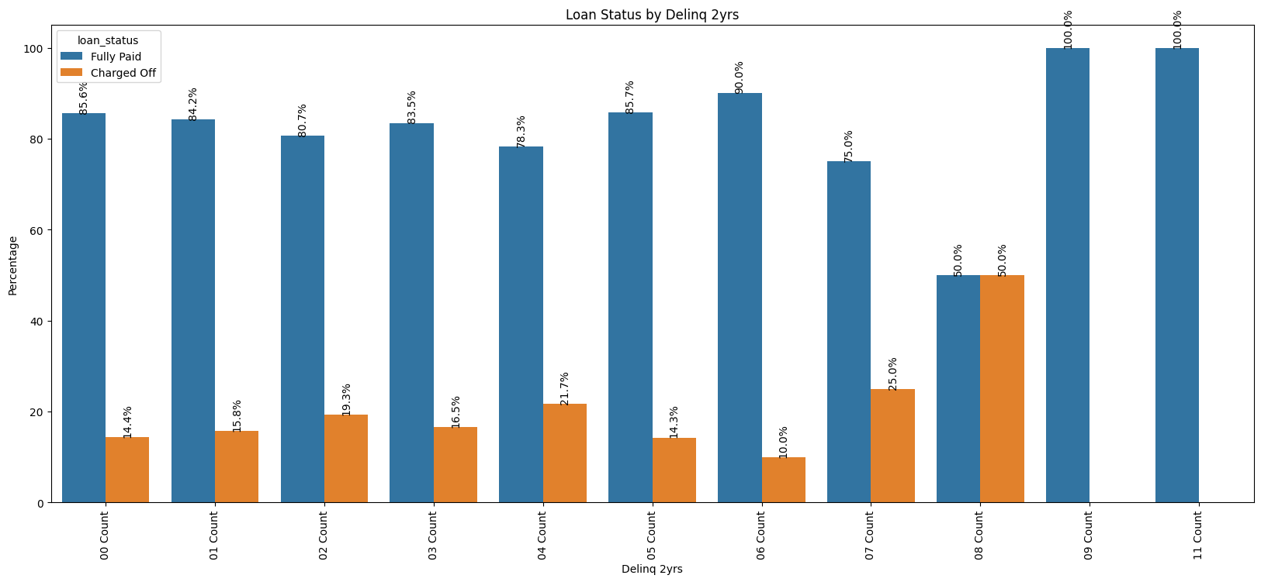
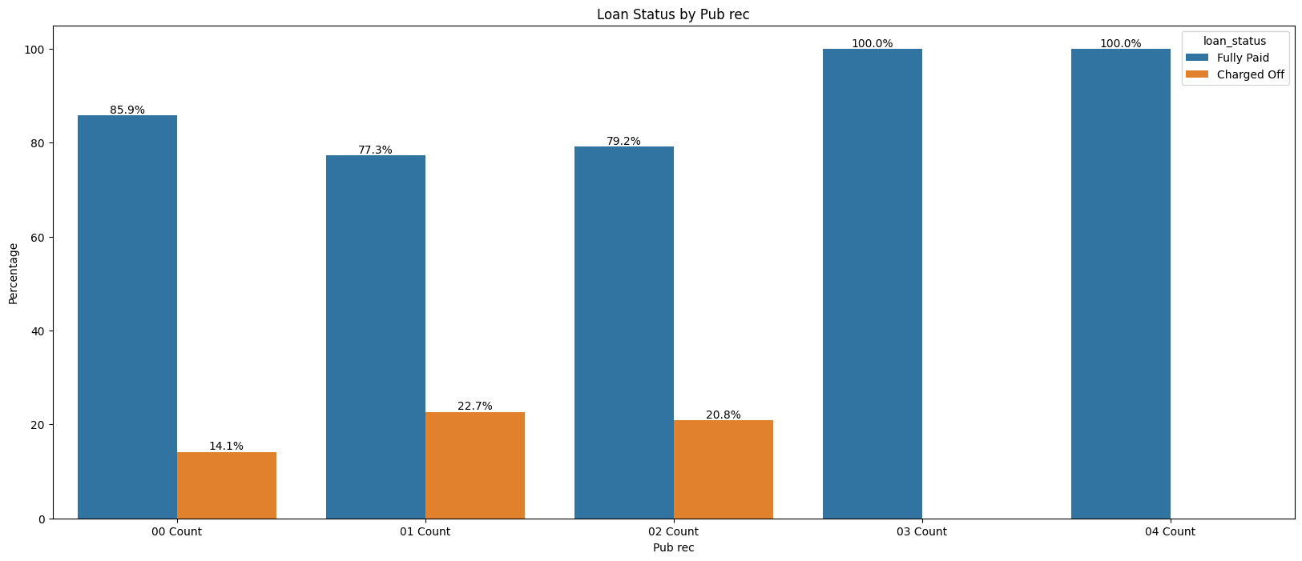
Key Insights –
Categorical Variables (Part-3)
Factors with Minimal Impact visible on charts:
Generally insignificant, but higher 30+days past due incidences of delinquency counts may indicate potential risk.
Public records have minimal impact on loan status.

Slide 13
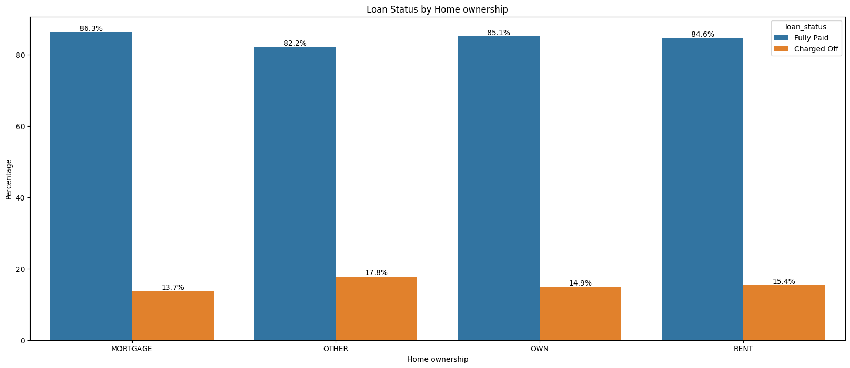
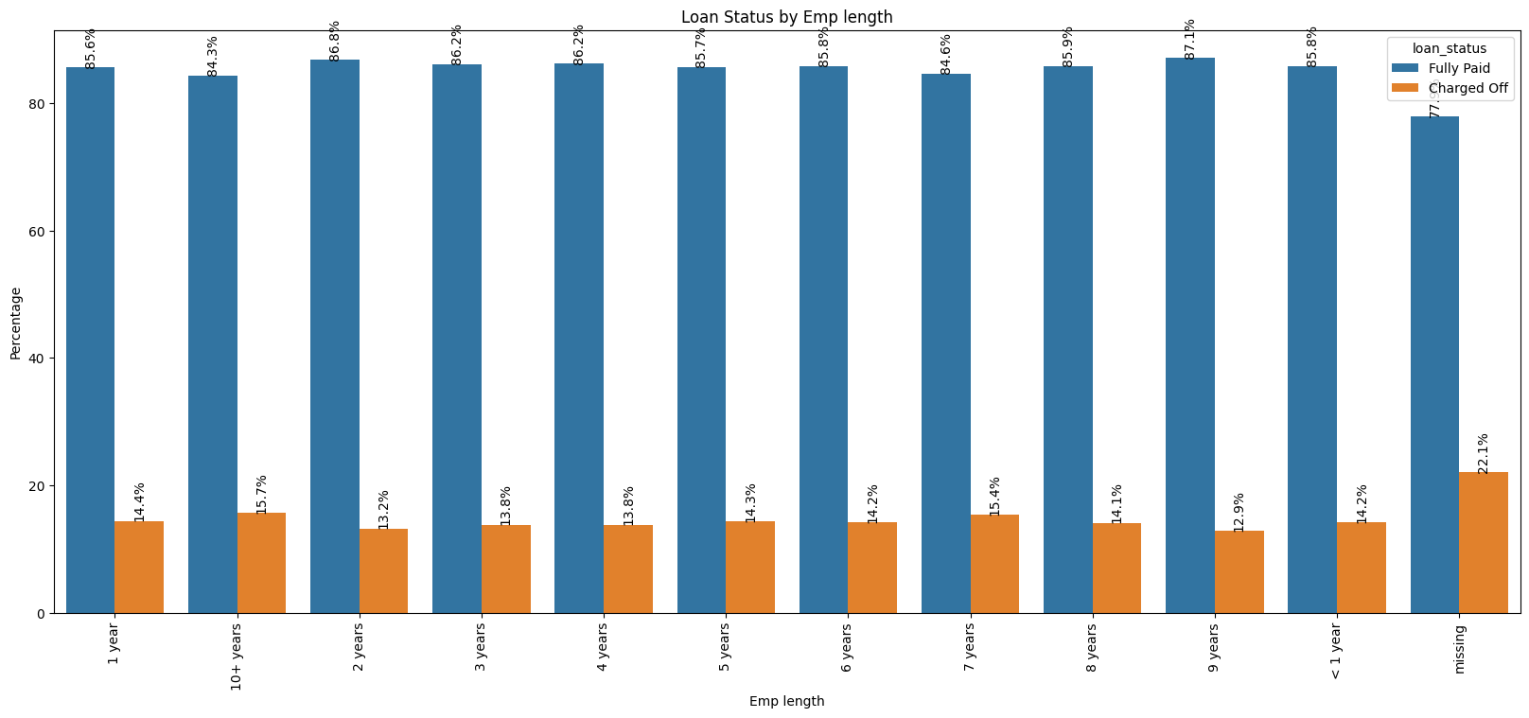
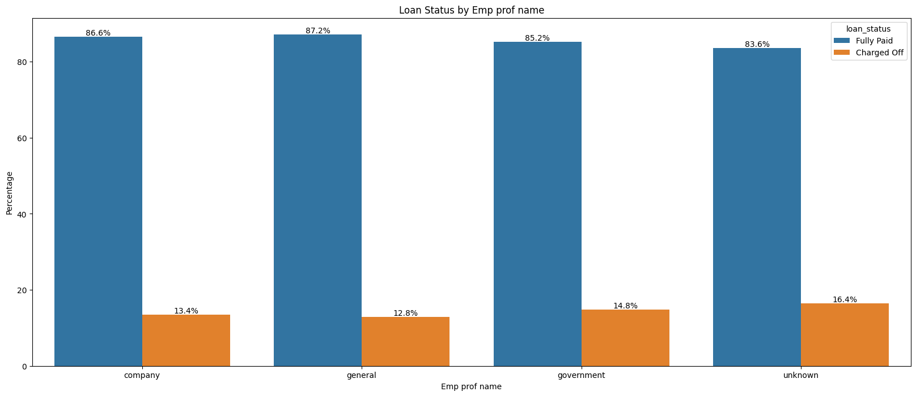
Key Insights –
Categorical Variables (Part-4)
Factors with No Impact visible on charts:
No significant impact of Employment length, though missing data shows a slight increase in default percentage.
No notable differences in default percentages based on home ownership.
Profession names show no strong relationship with default risk.

Slide 14
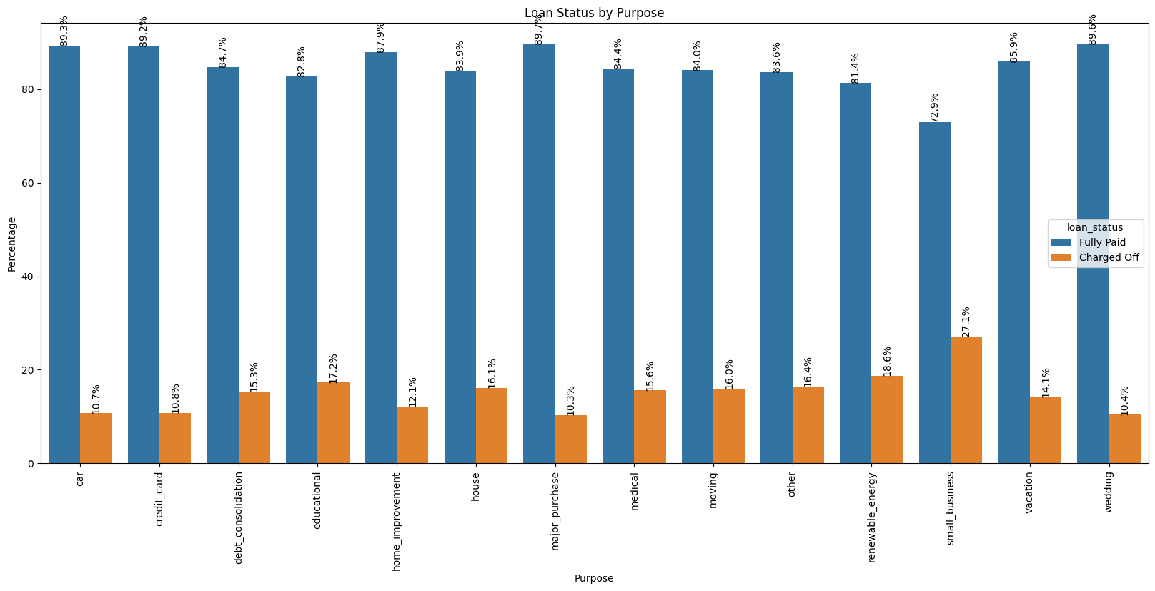
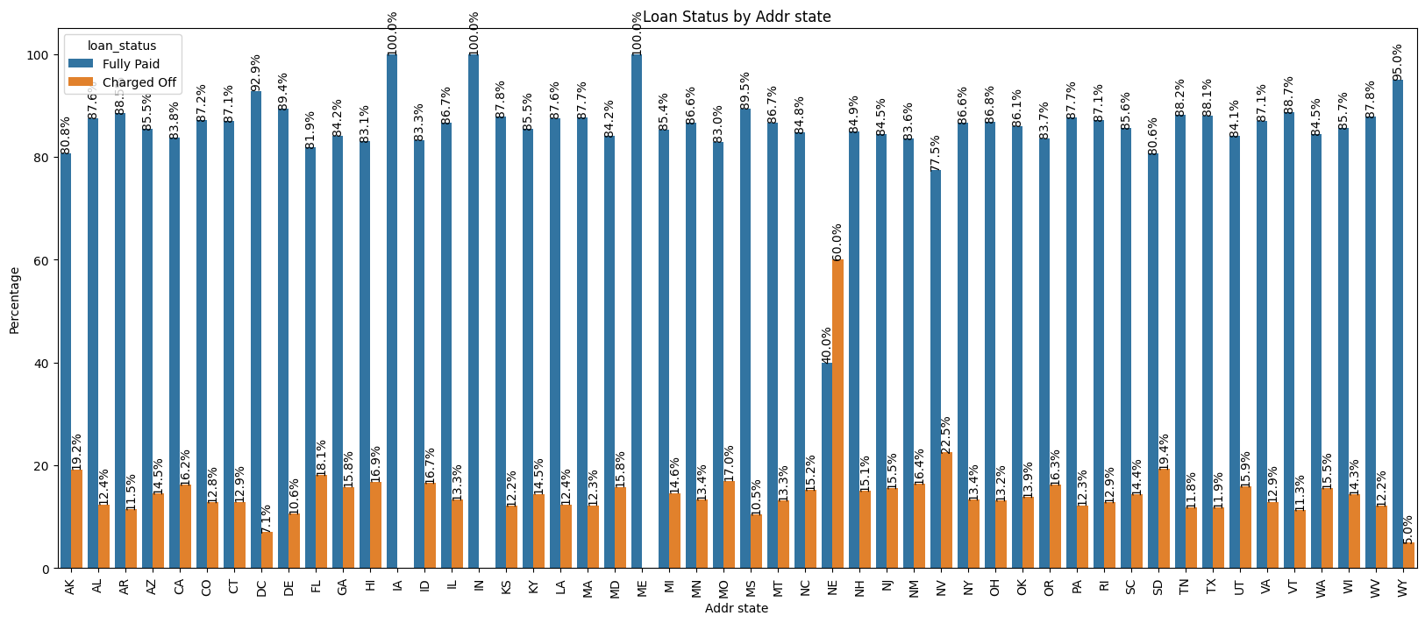
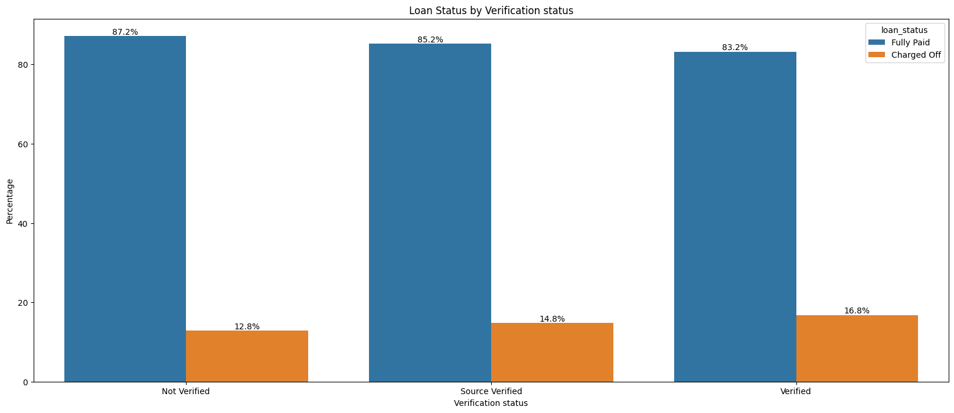
Indirect Impact Factors
Factors with No Direct Impact but Possible Indications:
Loans with a 60-month term have significantly higher default percentages, indicating a potential need to assess risk more rigorously for longer-term loans.
Verified applicants show a higher default percentage, suggesting potential flaws in the verification process.
Loans for small businesses have the highest default rates, indicating a need for stricter background checks for certain purposes.
Nebraska (NE) shows a 60% default rate, suggesting validation processes vary by state and may require improvement.

Slide 15
Recommendations
Revise credit approval policies for:
High loan amounts or interest rates or DTI ratio.
Higher number of open accounts or inquiries
Short credit history
Longer-term loans
Strengthen verification processes.
Strengthen Data collection like, Employee length (Employment experience year)
Implement stricter checks for:
Small business loans.
High-risk states like Nebraska.

Slide 16
Challenges & Assumptions
🍕Challenges:
Balancing outliers vs. noise.
Interpreting categorical variables effectively.
💡Assumptions:
Data accurately represents past trends.
Retained outliers to capture risk-related anomalies.

Slide 17
Conclusion
Identified key drivers of loan default.
Provided actionable insights to minimize credit risk.
Enhanced decision-making for loan approvals.

Slide 18
GitHub Repository
Link: insights-into-lending-risks
Reference: https://github.com/amaan2398/insights-into-lending-risks

Slide 19
Thank You

